Slide 1
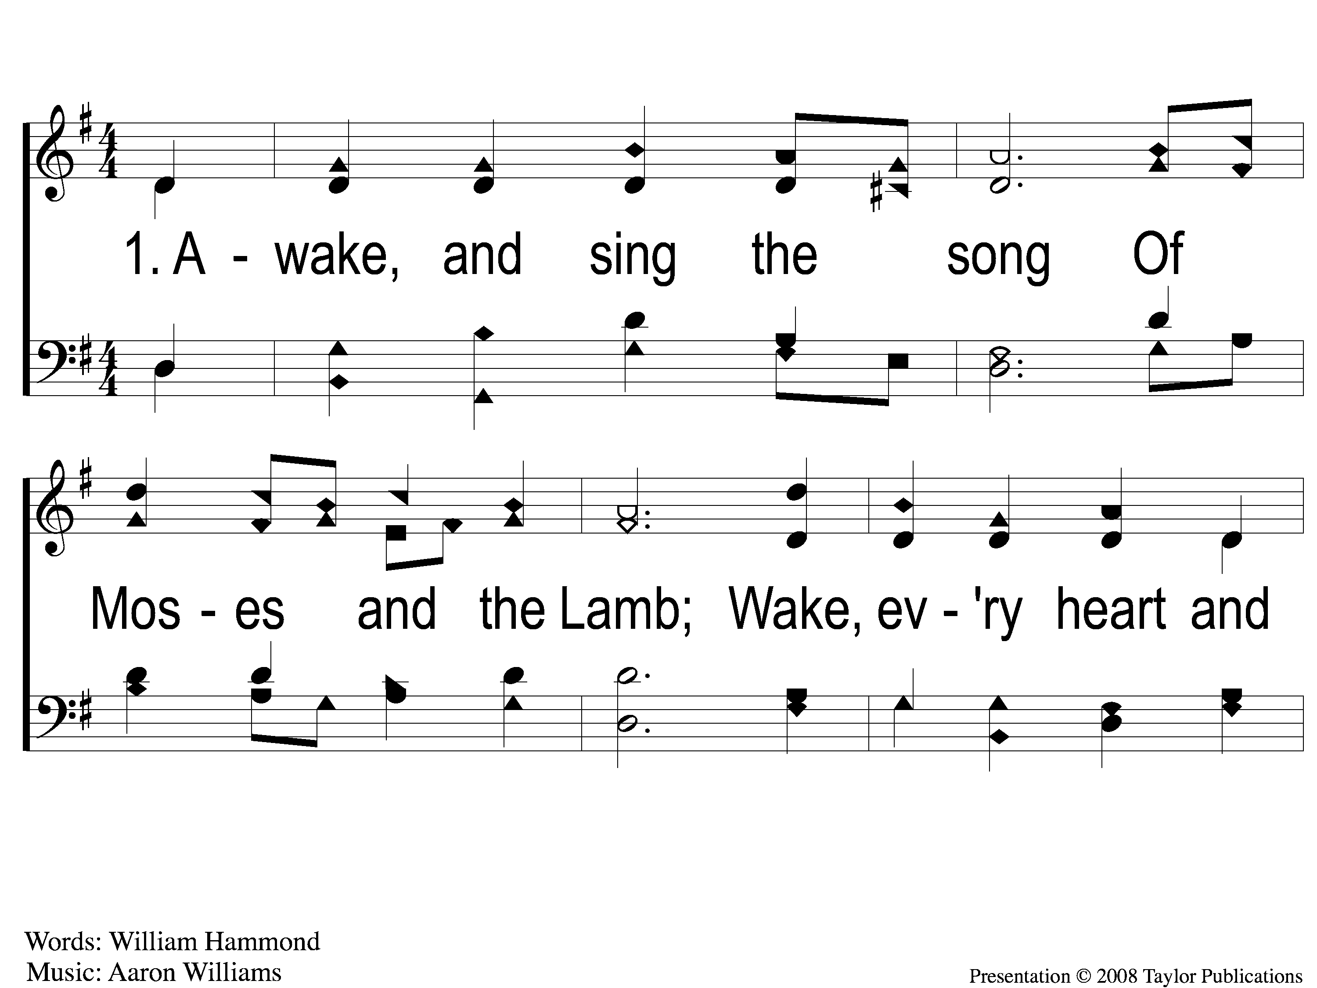
1-1 Awake and Sing the Song
Awake and Sing the Song
33

Slide 2
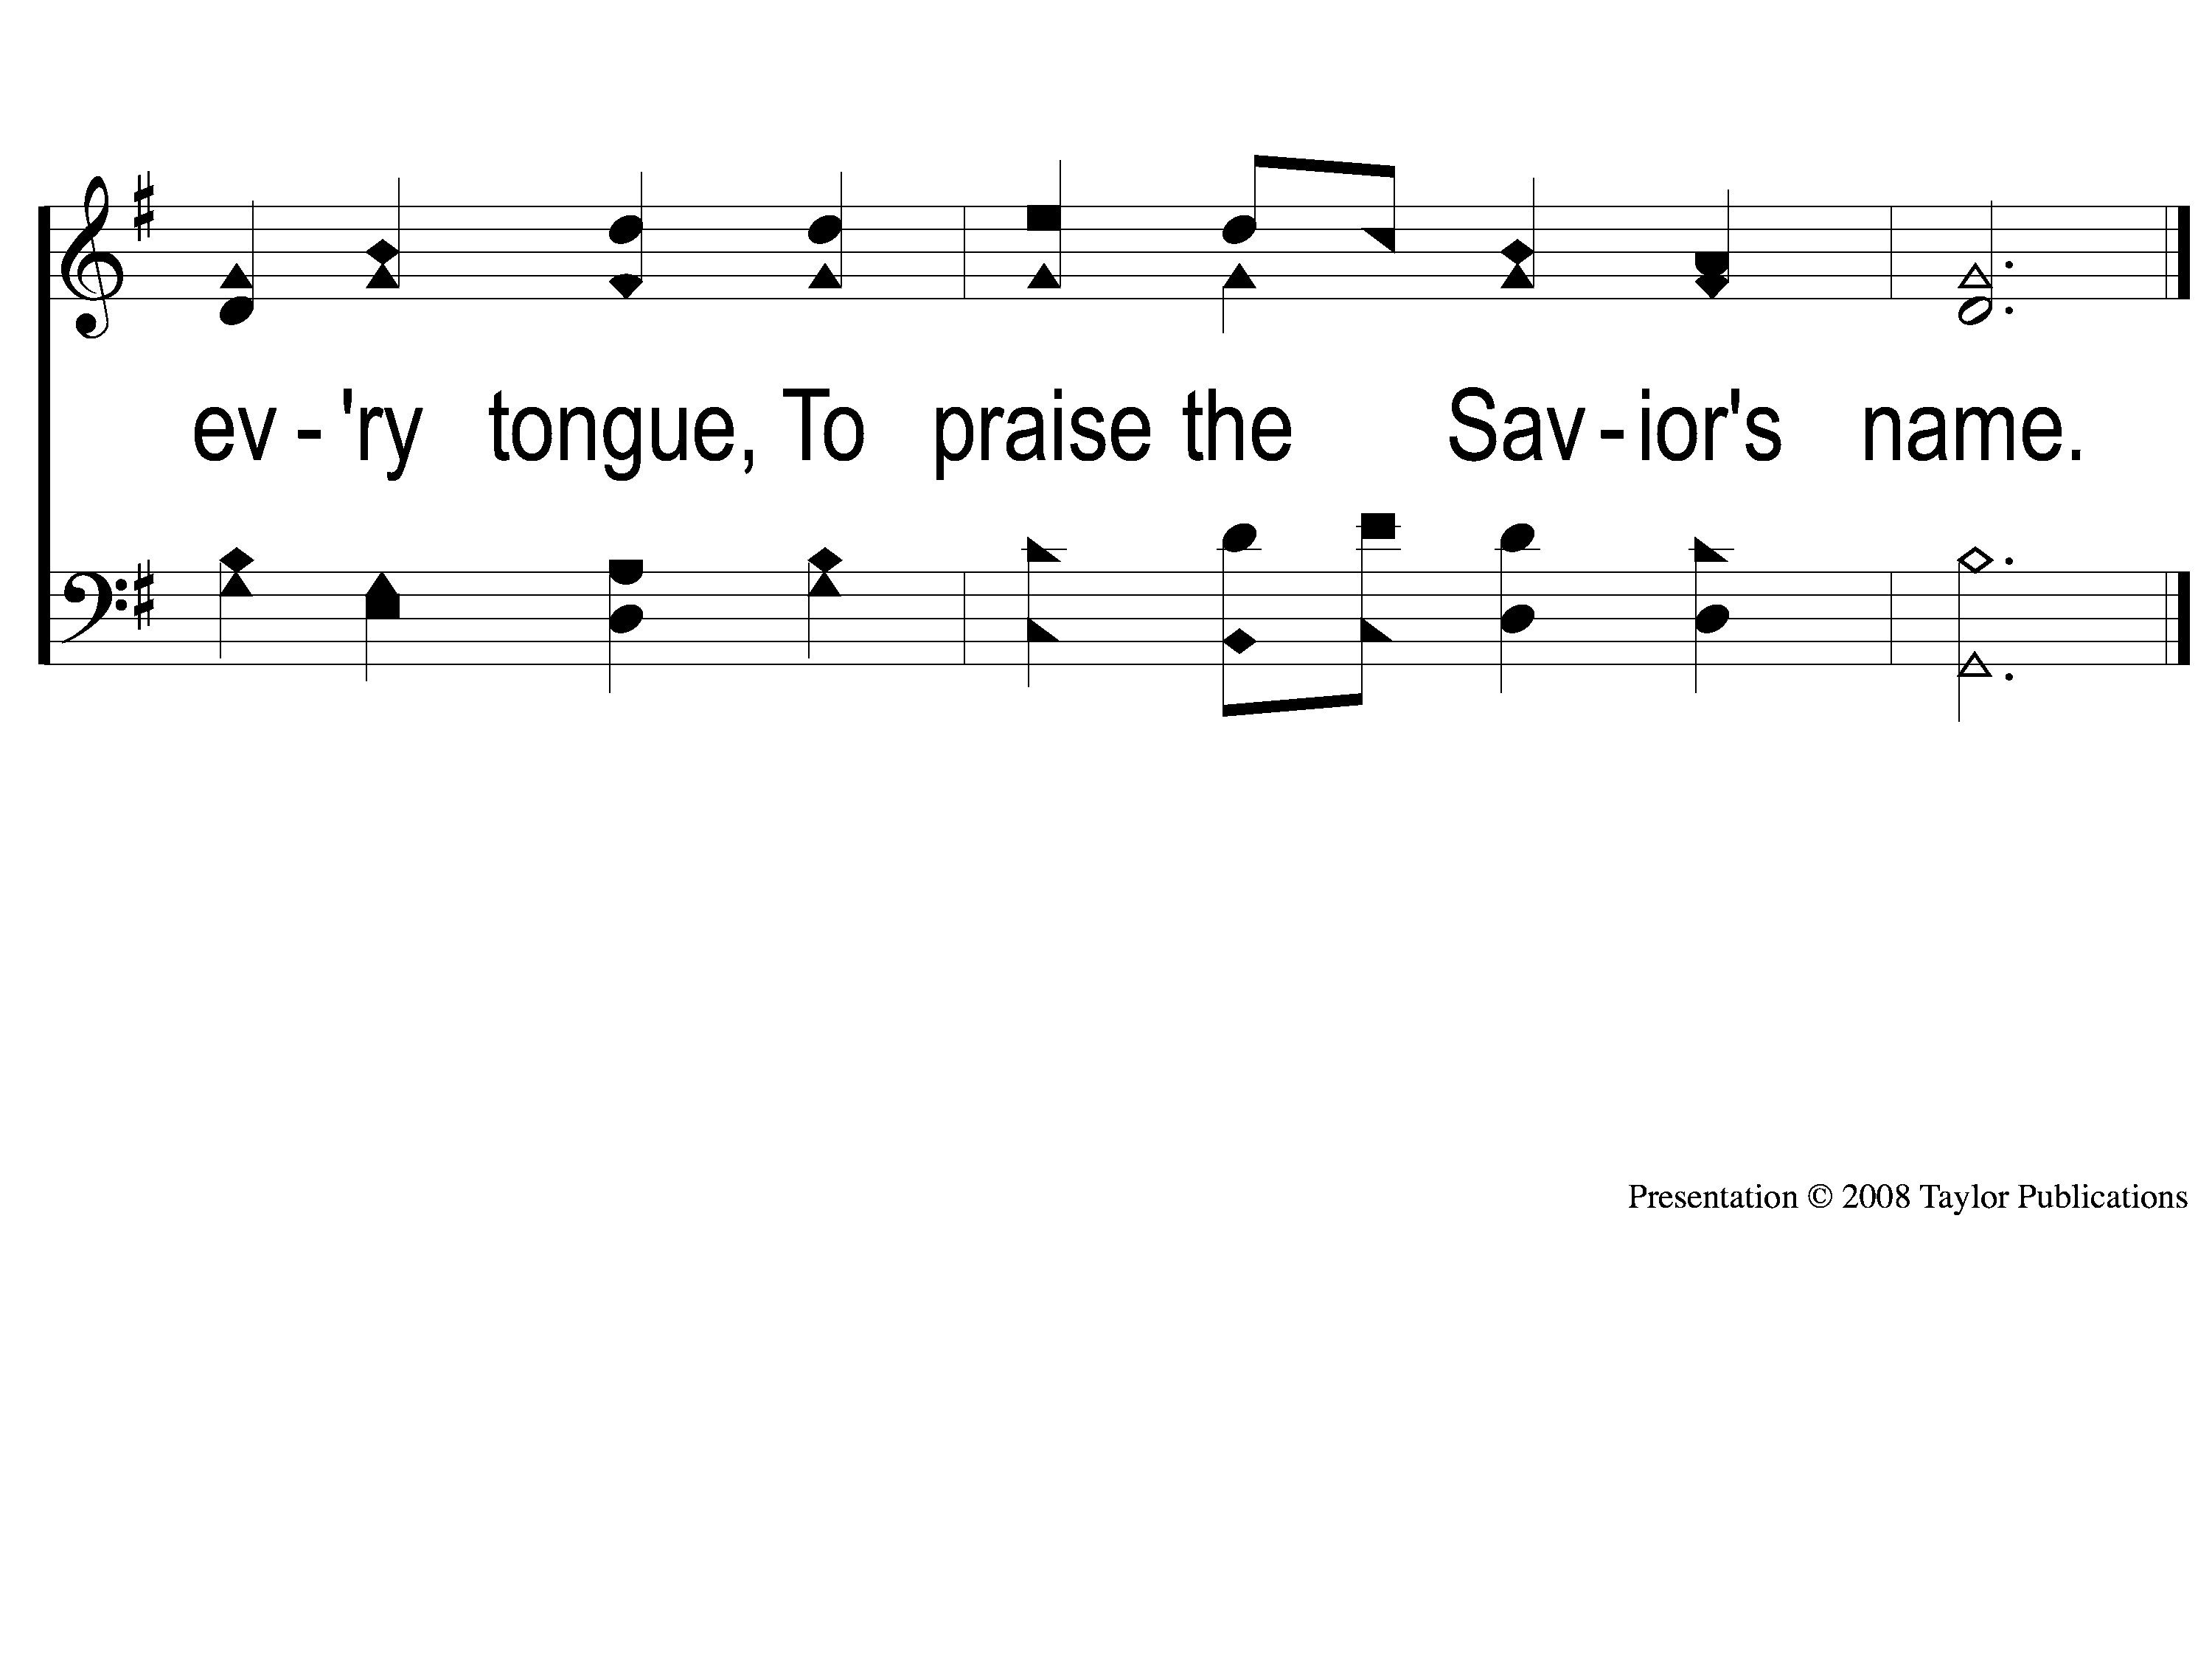
1-2 Awake and Sing the Song
Awake and Sing the Song
33

Slide 3
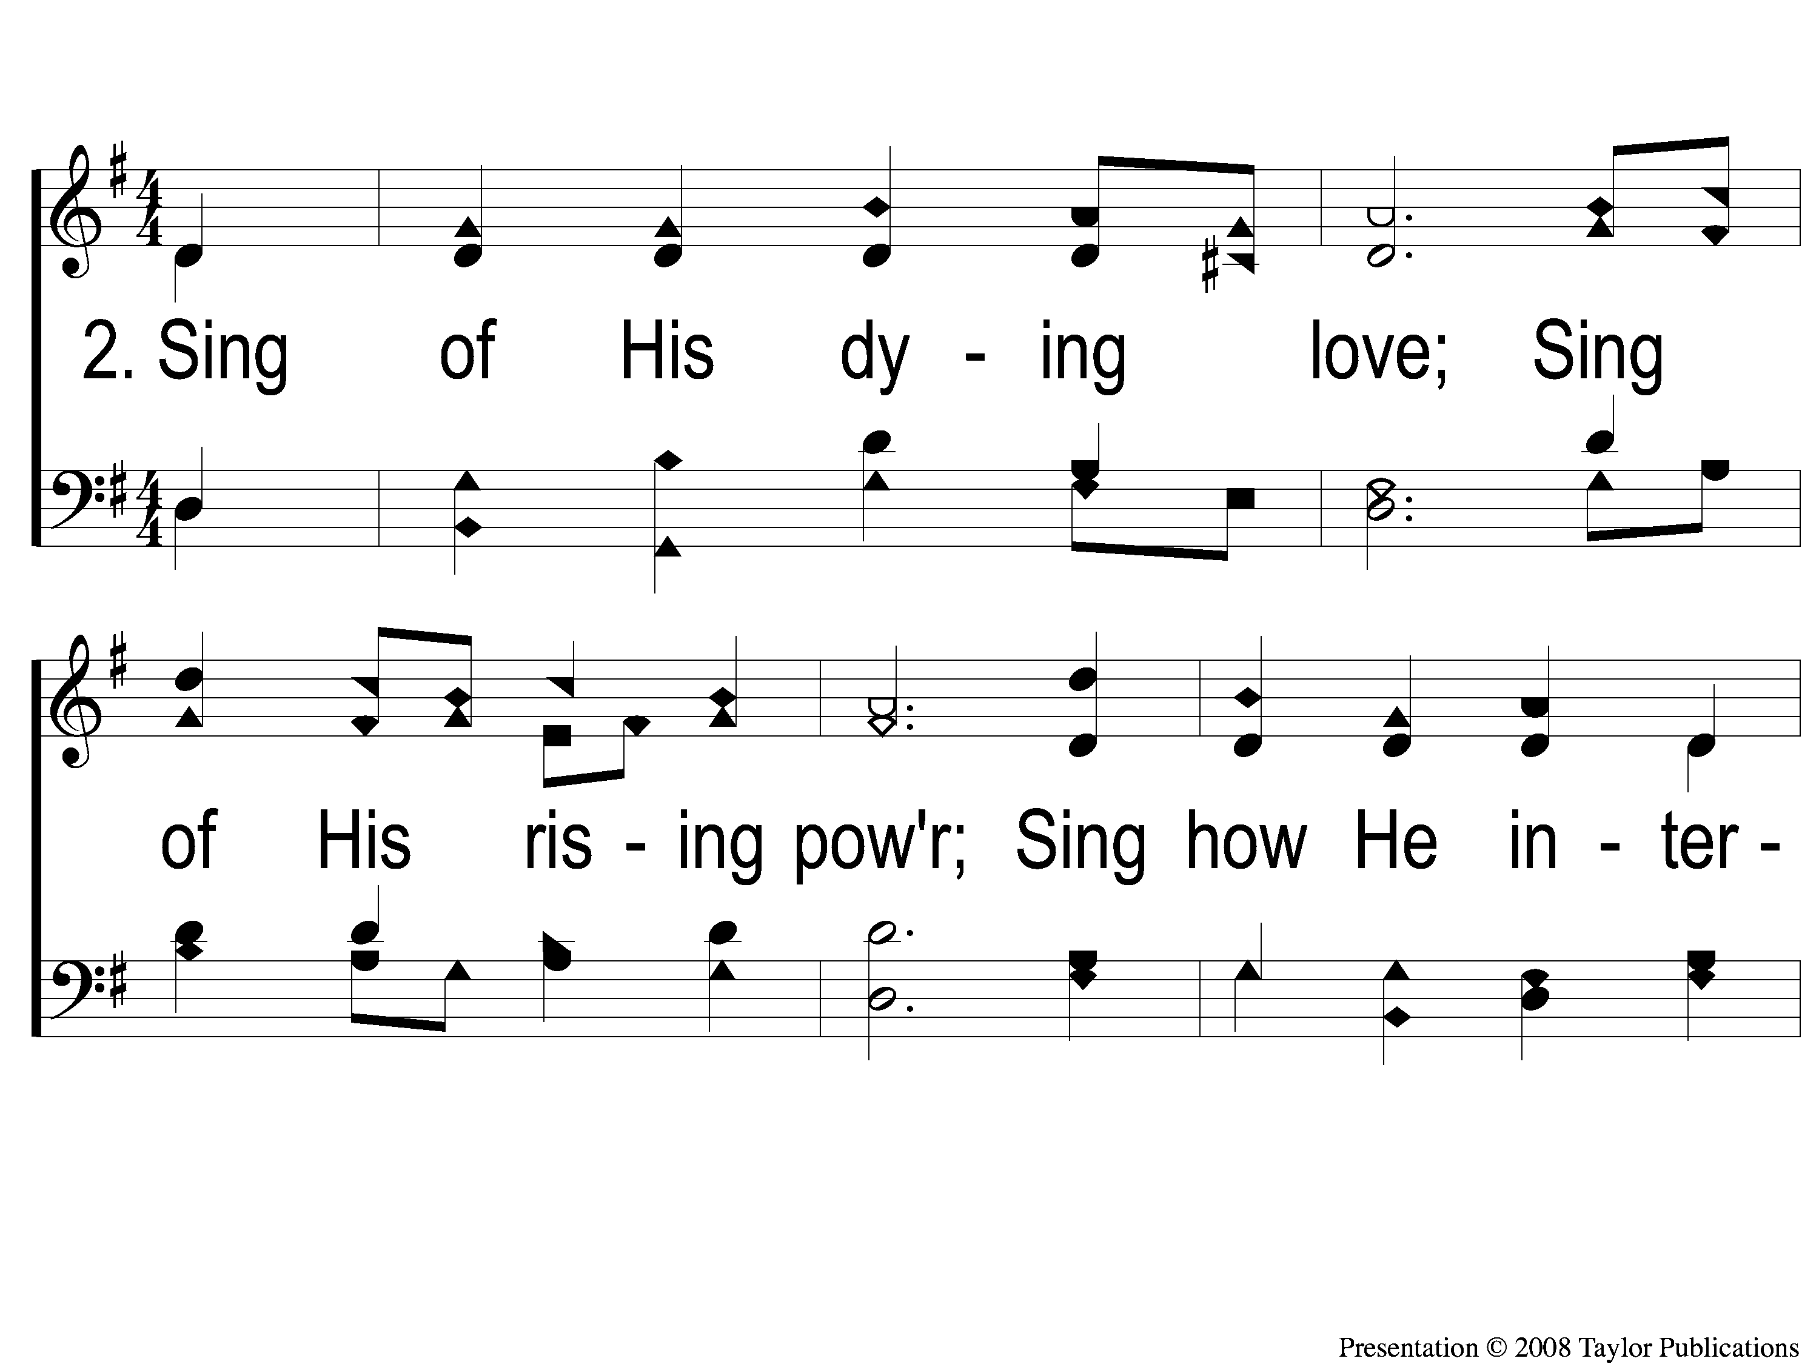
2-1 Awake and Sing the Song
Awake and Sing the Song
33

Slide 4
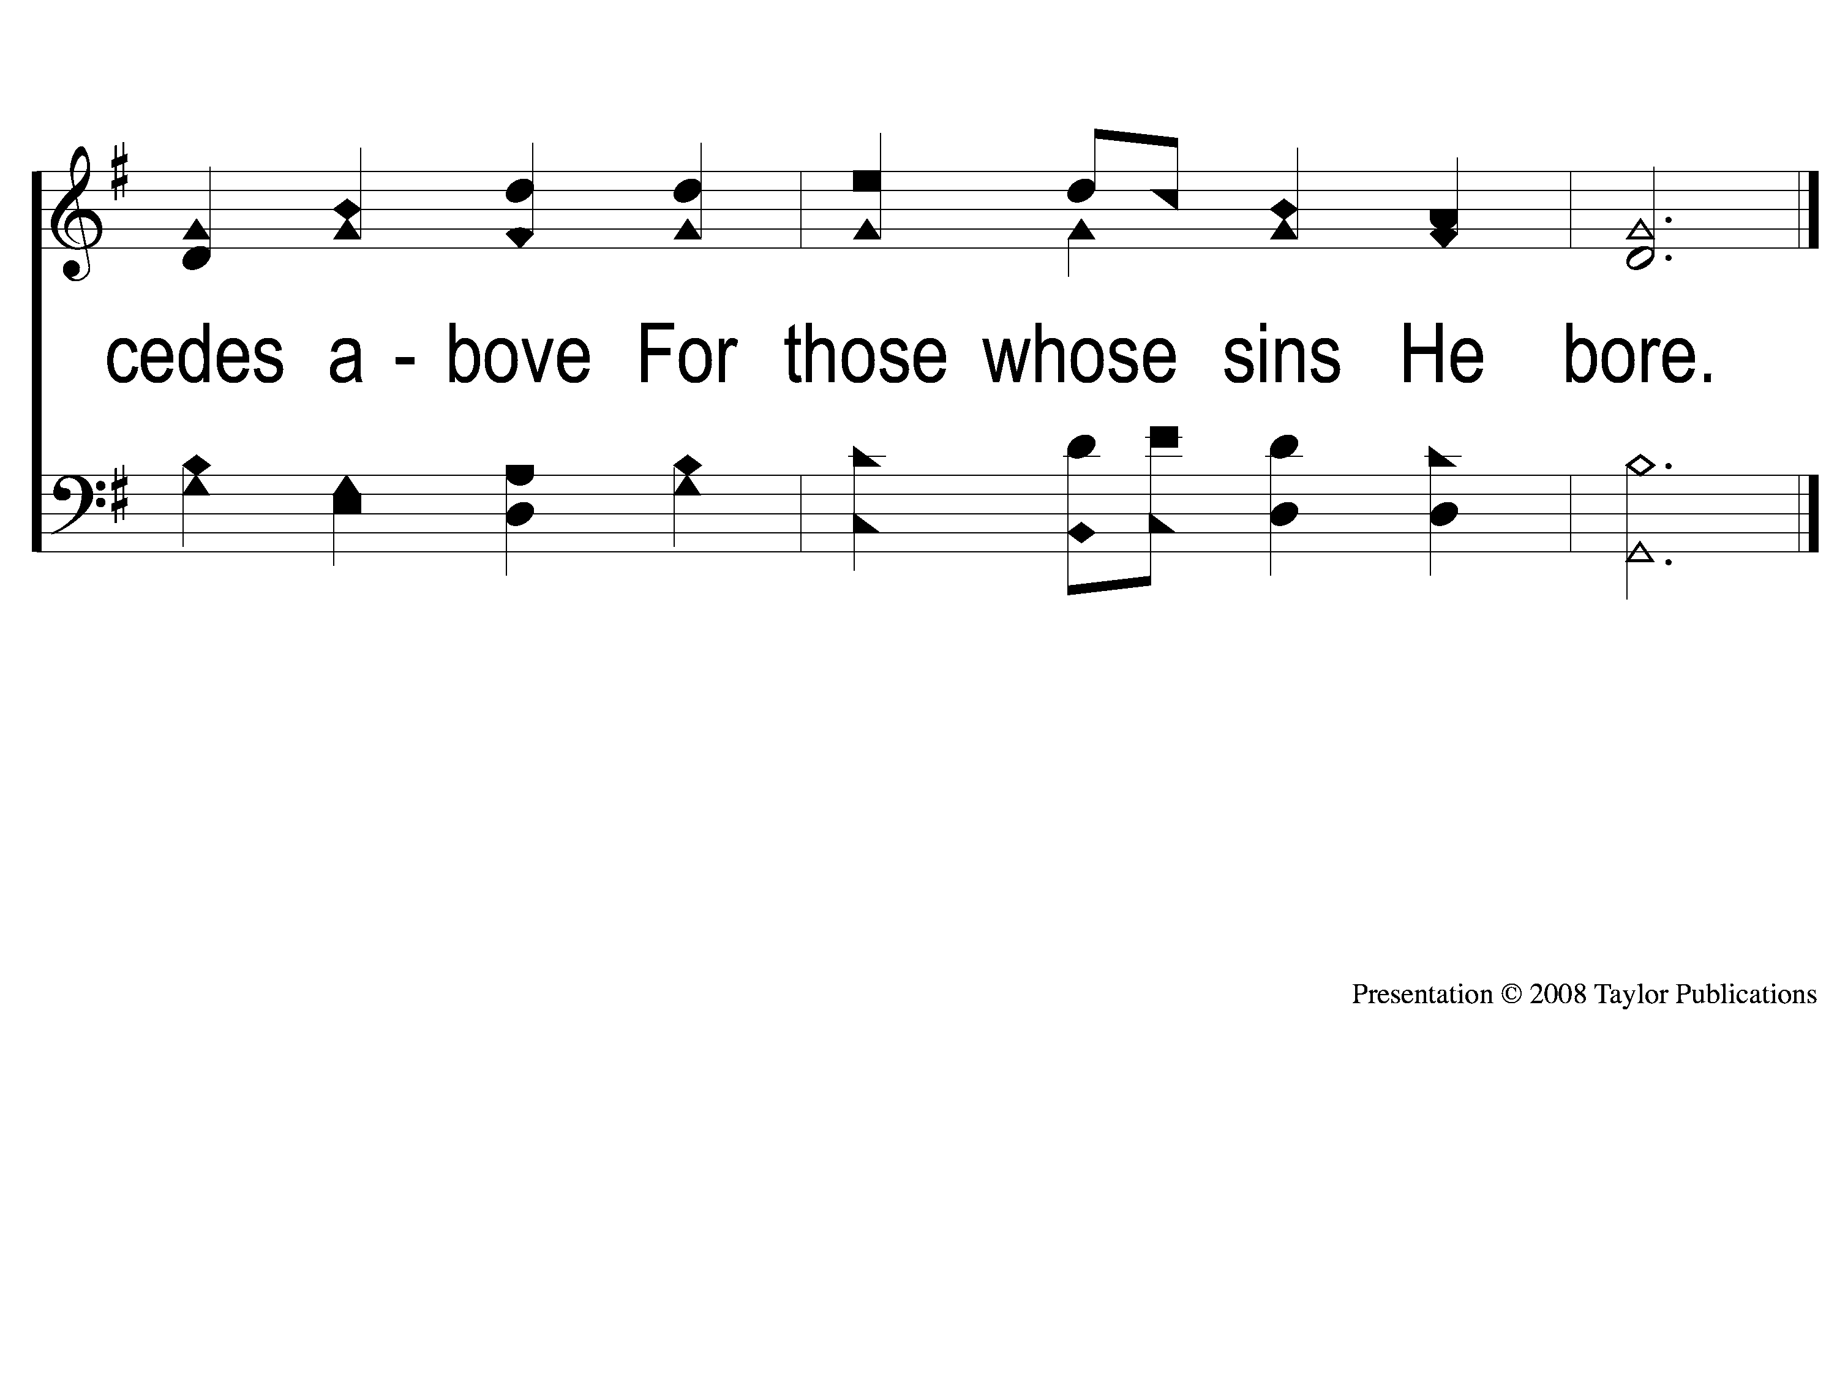
2-2 Awake and Sing the Song
Awake and Sing the Song
33

Slide 5
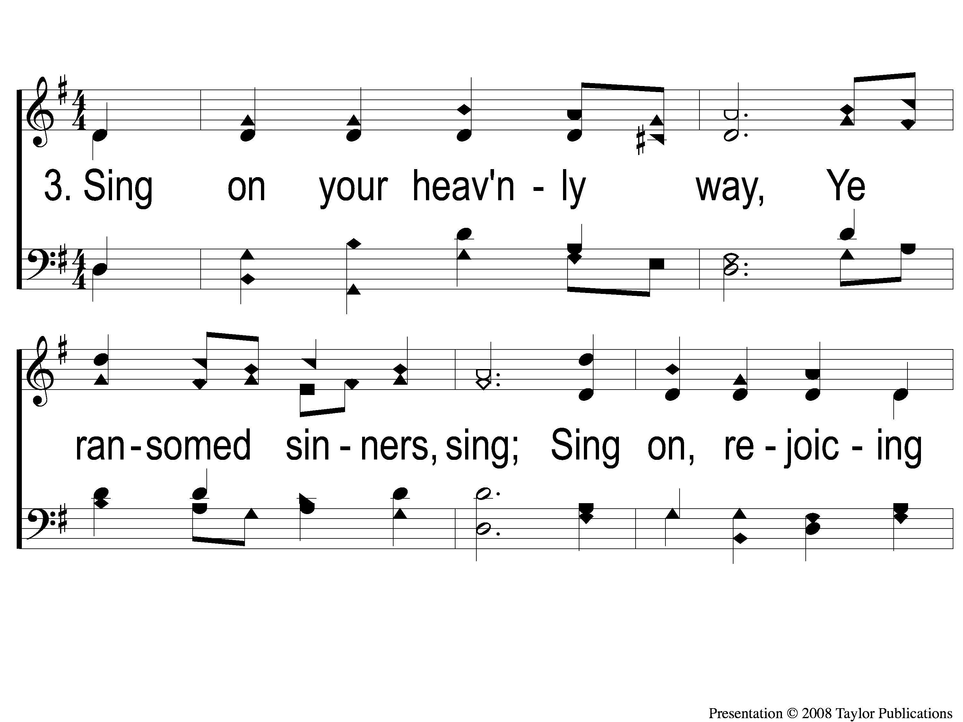
3-1 Awake and Sing the Song
Awake and Sing the Song
33

Slide 6
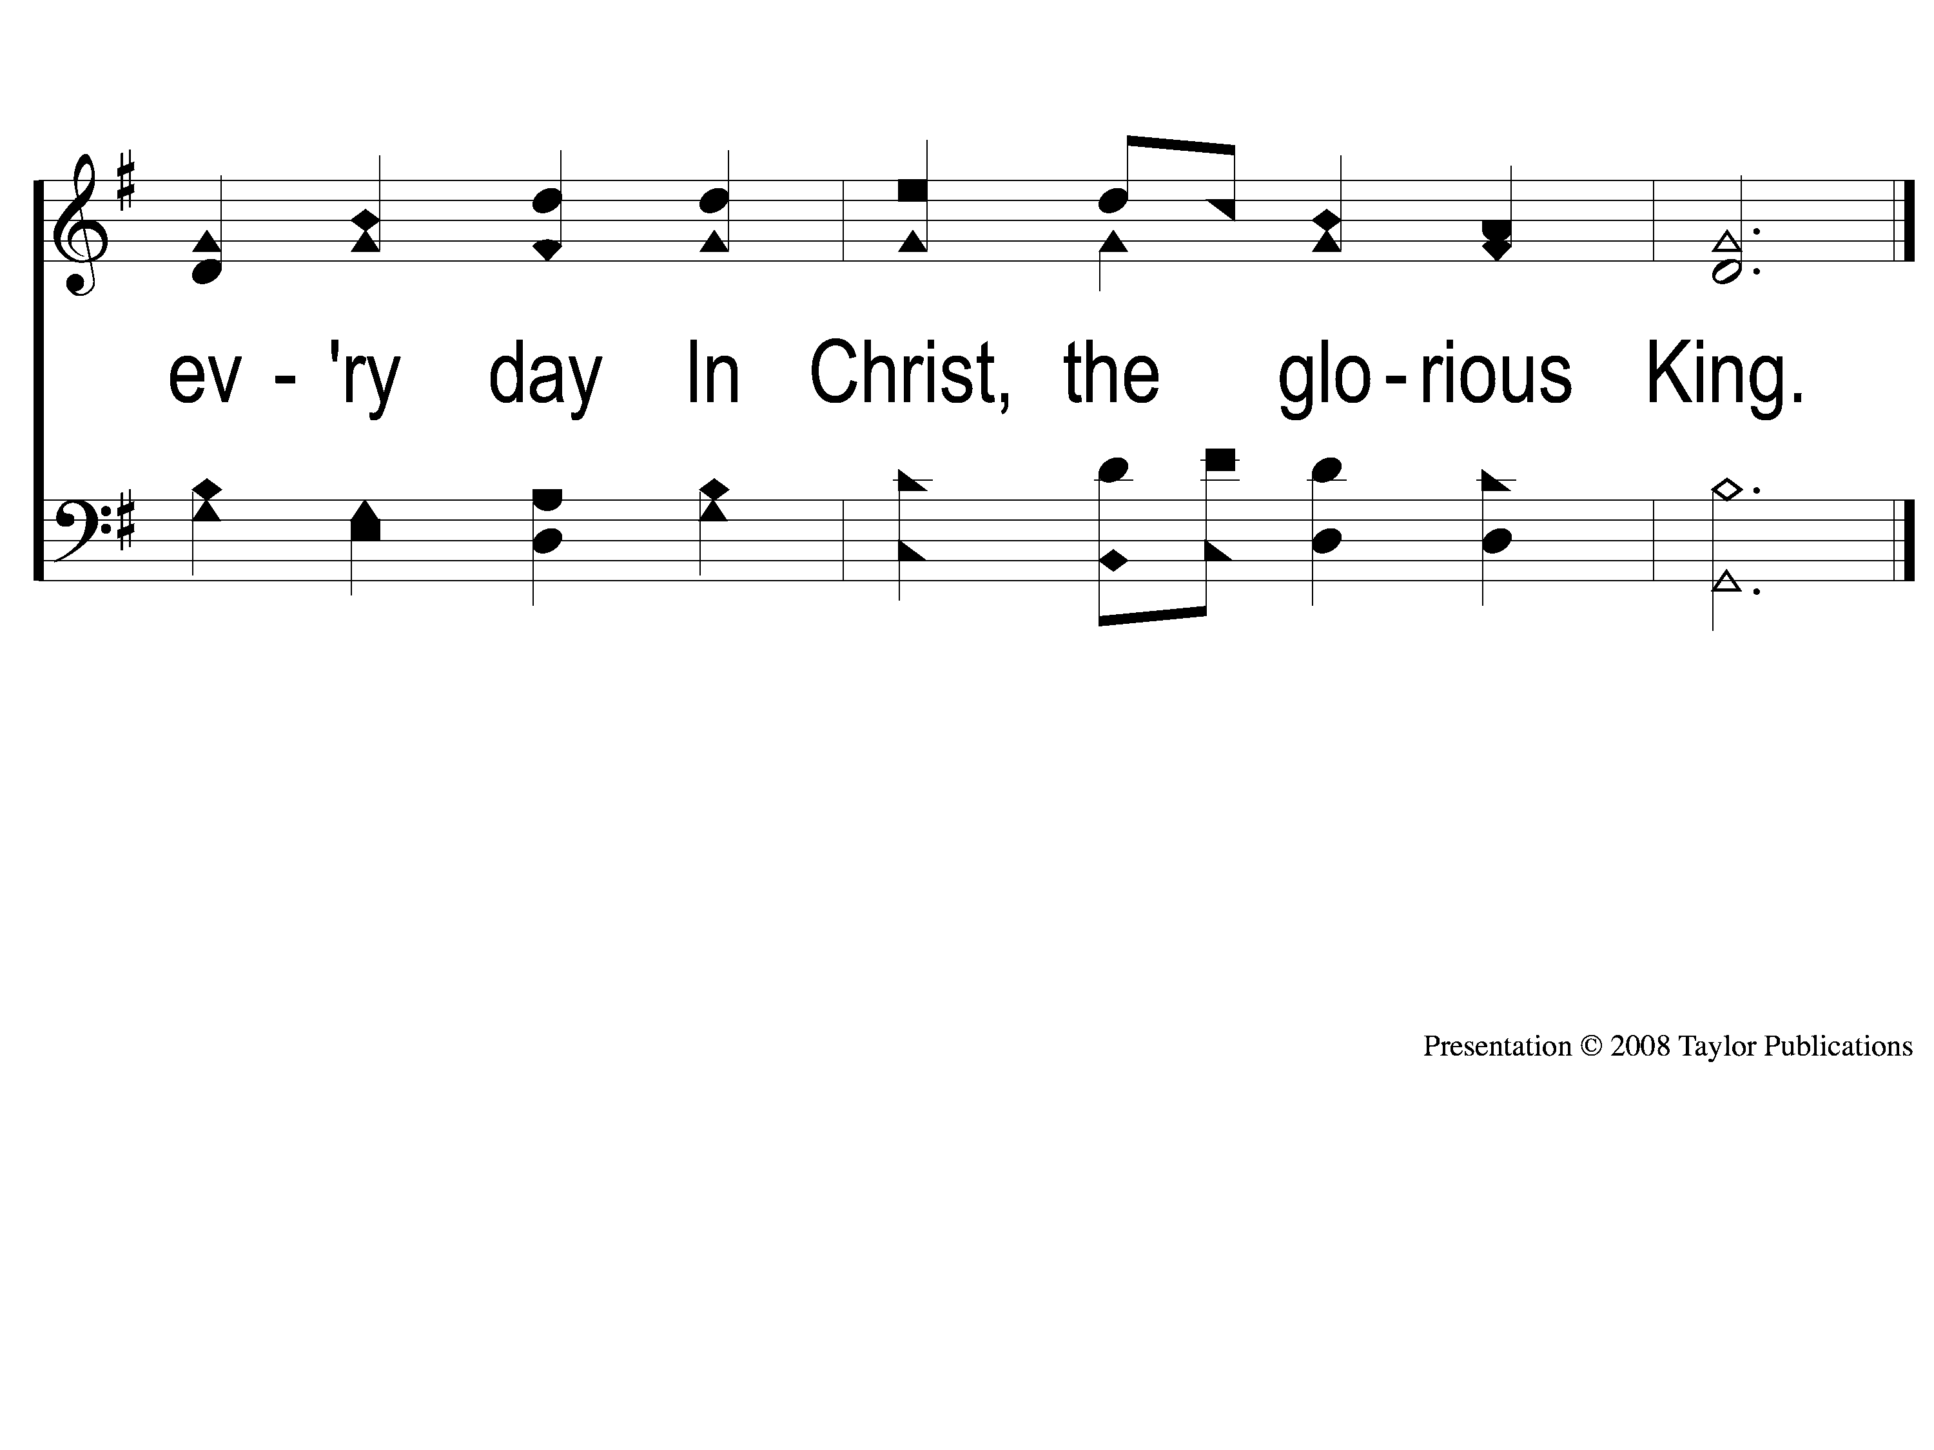
3-2 Awake and Sing the Song
Awake and Sing the Song
33

Slide 7
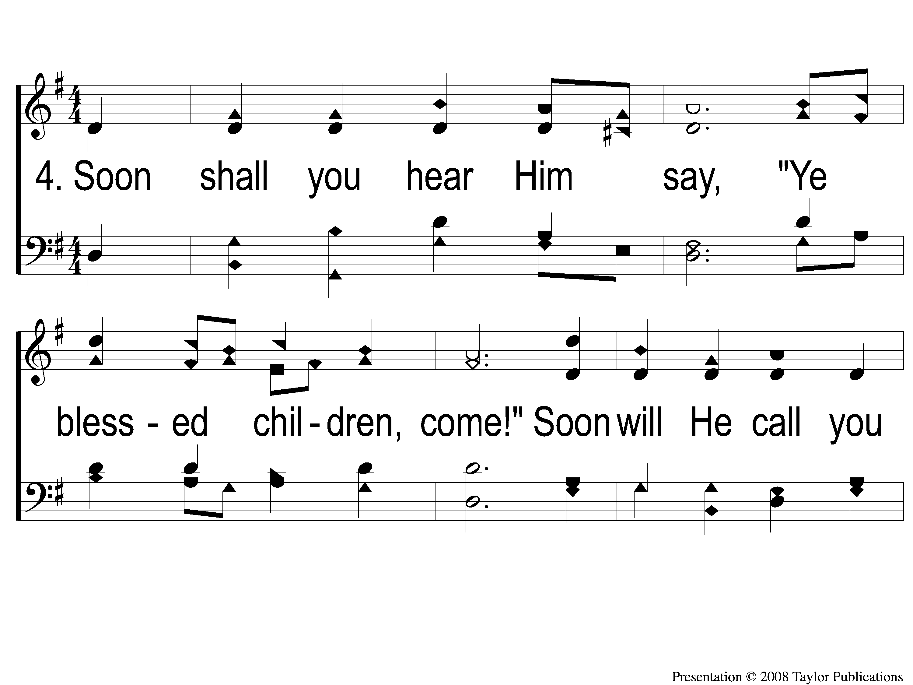
4-1 Awake and Sing the Song
Awake and Sing the Song
33

Slide 8
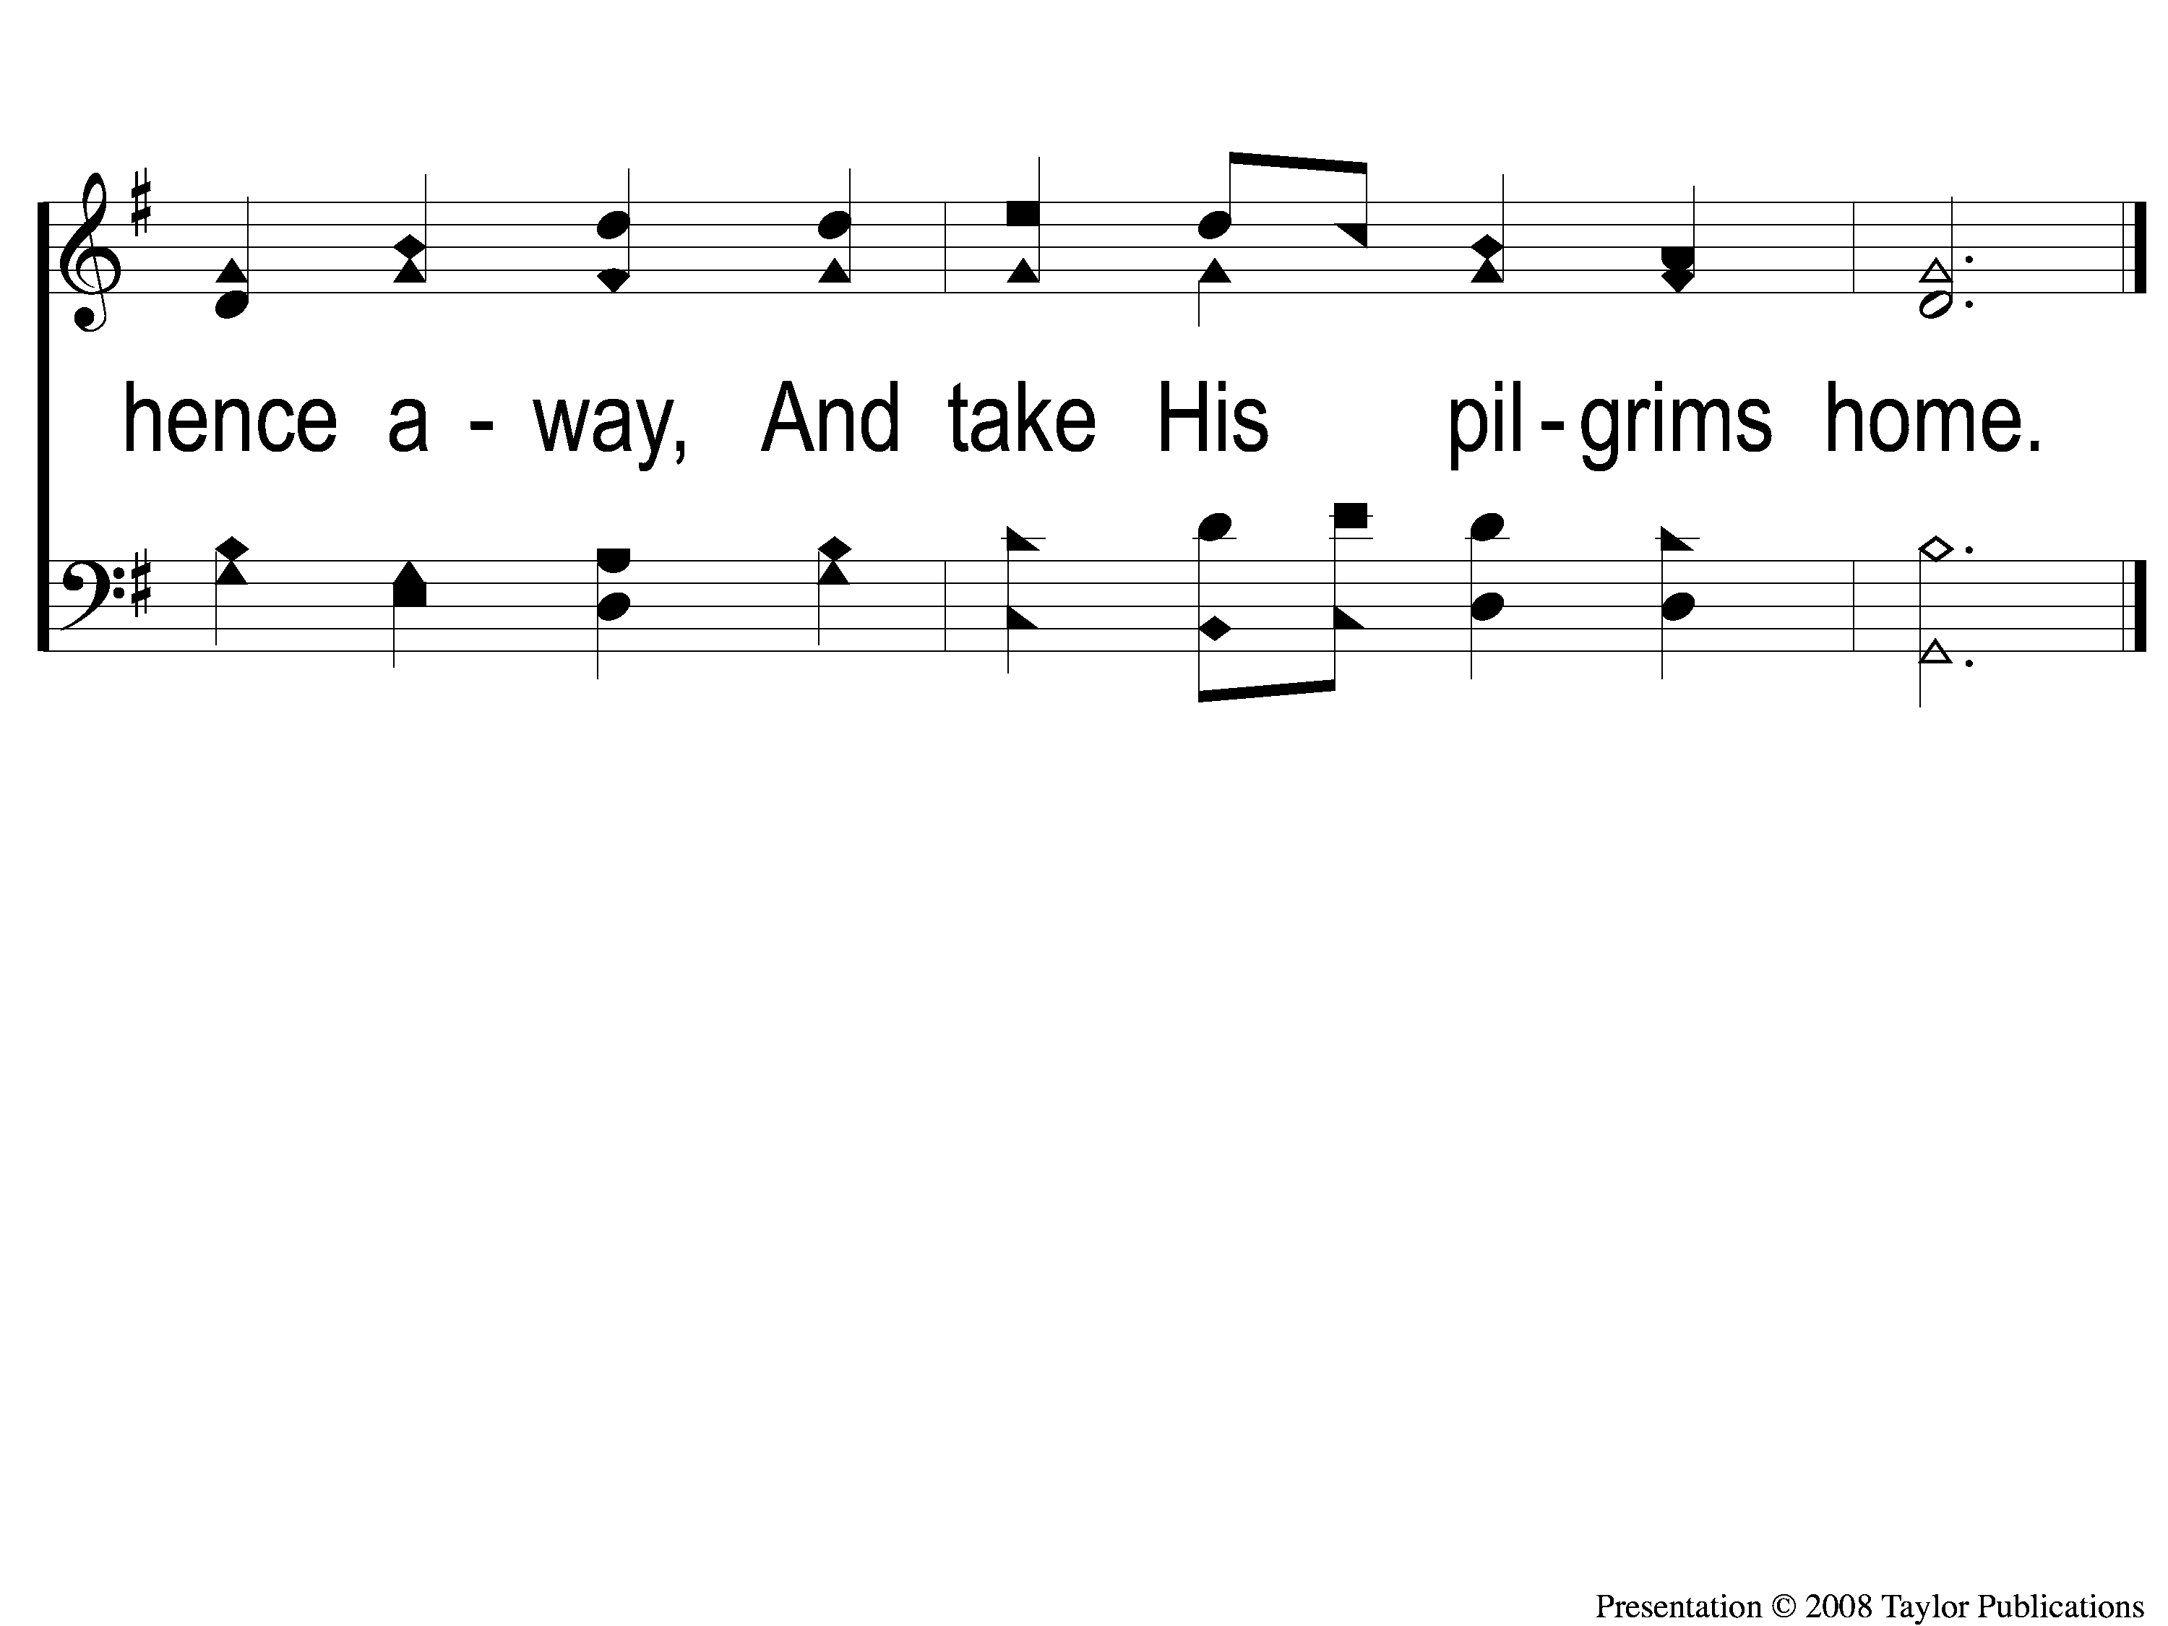
4-2 Awake and Sing the Song
Awake and Sing the Song
33

